Slide 1

BIG DATA
“HELLO, WORLD!”
A FOUNDATIONAL INTRODUCTION
TO HADOOP AND HIVE
USING MINIMAL EXAMPLES
MAR 17, 2014
FRANCIS BROWNE

Slide 2
WHAT IS BIG DATA – THE HIGH LEVEL VIEW
Big Data
“Big Data” is a buzzword that we hear everywhere. Within BNYMellon, we hear it most often in the context of the Activity Engine application, and the “Data Lake” strategy.
But what is it, really? What is the lowest common denominator of technical tools that are commonly used in this space? What would a big data “Hello, World!” example look like?
Big Data is
A series of tools for using data at volumes (over 100 million records, a terrabyte of inserts per hour, etc) that far exceed what relational databases such as Oracle can handle
An approach that has its own significant costs and limitations
…but makes possible things that are otherwise impossible.

Slide 3
THE EVEN HIGHER-LEVEL VIEW:
BIG DATA AND MOBILE ARE TWO SIDES OF THE SAME COIN
THE CLIENT IS CHANGING
  Its not all about desktop web applications serving up page per click architecture pages to a single browser version any more.
  New business models on mobile platform and public websites tend to tiny profits per transaction over massive volumes.
  AJAX means the web browser can respond instantly and allow complex user interaction. (You can write a client-side paint program. I did.) Makes Single Page Architecture possible (think Google Maps).
  Mobile Uis on tablets and smartphones have different paradigms
    They tend to have intermittent network - connections
    Multitouch Uis
    Lots of sensors in the hardware (tilt, shake, camera, etc)
    Thich client Apps provide the best user experience
    But companies have lots of HTML knowledge and code to leverage
  Leads to Mobile Hybrid thick client wrappers and Single-Page Architectures of heavy Javascript apps for UI.
  Social enterprises in the new tech world order capture far, far more data – from mobile client sensors, click streams, even mouse pointer movements, in the hope that it may be used later. Much higher data volumes produced.
THE SERVER IS CHANGING
  Active/Active across datacenters? It gets tricky when you’re backed by a relational Database. Reads of data can be replicated, but writes become problematic.
  “NoSQL:” Many new types of data stores invented – column oriented DBs, Graph DBs, etc. Forsake ACID integrity for greater flexibility and performance, and (sometimes) eventual consistency.
  Much greater data volumes consumed. Major players today like Amazon and Facebook capture gigabyte to petabyte streams of data continuously. This data would overwhelm a RDBMS’s insert speed.
  BNY Mellon API initiative would create even more data firehosing – capture each invocation, and its lifecycle. Learn and profit from all of it.
  Analytics on this stuff requires Map/reduce parallelized architecture. “Big Data.”
  BNY Mellon
    has >2 Petabytes of data we are just beginning to figure out how to run NoSQL Analytics on.
    Twitter and Facebook have simple data compared to ours. They have fairly monolithic, essentially loosely structured data. We have thousands, many thousands, of silos built to support specific business functions.
    Now we need to build modern tools to see across those silos using things like Hadoop MapReduce, Cassandra, and Hive.

Slide 4
THE BIG DATA ECOSYSTEM
The F/OSS Big Data Stack
The Big Data ecosystem is constantly evolving and changing, but what we are going to consider here are the foundational tools and approaches (HDFS and MapReduce), and one tool built on top of them (Hive) which is a) used by Activity Engine, and b) a good example of the way other Big Data projects build atop HFDS and MR.
Hadoop HDFS: store your data, in flat files, on a very large cluster of cheap commodity hardware which is allowed to fail.
    Google and Yahoo run data centers of hundreds of thousands of commodity PCs and disks instead of servers and mainframes
    HFDS distributes your data (shards) between systems so that there is more than one copy of everything.
    Very high performance.
    It knows your network topology, and tries to minimize the cost of sharing (data locality).
  Hadoop MapReduce: execute a Java (or other) batch job on many nodes at once. Parallelism, but with a twist:
    It knows which data is where in HDFS, and will spawn MR nodes to run on data which is already on the same server, or nearby.
    Elegany and very powerful (but somewhat low-level) API for concurrent programming.

Slide 5
CHALLENGES OF THE BIG DATA LEARNING CURVE
Parallelism is hard. No matter how you do it, coding your own parallelism is hard.
    Map Reduce is a lot more powerful than 90s-style tools such as MPI, because it expects your data, not just your CPU needs to be large, and knows data locality.
    But you still have to design and tune MR jobs, and the learning curve is nontrivial.
Hadoop doesn’t install via apt-get. No vanila “normal” Linux distribution yet gives you working big data tools in the out-of-box manner that they give you other developer tools.
    Hortonworks has a sandbox VM image, and while that is comes out of box with a nice to use web front end for the higher-level tools such as Pig, I found that for Map Reduce and Hive, nothing beats installing and running it yourself “from scratch” for gaining understanding.
Query tools look like SQL but have vastly different edge cases and tuning semantics than RDBMSes. After this presentation, you should understand why.
    In particular, in RDBMSes it is quite normal to save data now, and decide what you will want to query on later, and support ad hoc queries at high performance.
    In an RDBMS, a full table scan is a fatal performance problem. In HDFS/MR, it is situation normal, and is even more costly than in Oracle. This sounds like a bug, but is in fact a feature. We’ll explain why.

Slide 6
GOALS OF THIS PRESENTATION
Show only a very simple example of HFDS, MapReduce, and Hive. This stuff is new to me, too, but I learned enough getting Hadoop to “Hello, World” that I thought it was worth sharing.
Give enough pointers to enable a developer to create a working single-node Hadoop cluster on a personal Linux machine.
Demonstrate the most fundamental concepts of MapReduce, as well as HFDS underneath it, and tools like Hive built atop it.
This presentation is not going to address:
    Performance tuning of working MR jobs (how many mappers, how many reducers, etc)
    How to set up your own multi-node cluster
    Nontrivial examples of MR or Hive (really, I mean it)
    However, I will supply a reading list that does address that sort of thing.

Slide 7
HISTORY OF THE MAP REDUCE PARADIGM
History
The basic Map Reduce paradigm was invented by Google internally, and described in a paper. Source code was not provided.
    The underlying concept is drawn from functional programming world (Lisp). Map - applies the n-arg function (here plus) to n lists
  (defun increment (x) (+ 1 x))
  INCREMENT
  (map 'list #'increment '(1 2 3))
  (2 3 4)
  Reduce applies the function to the first 2 args of the list, then folds in each successive one. So to sum
  (reduce #'+ '(1 1 1 1))
  4
  (reduce #'+ (map 'list #'increment '(1 2 3)))
  9
But Google’s paradigm is much more – using an approach like that to make running distributed code, across distributed data, on cheap (breakable) hardware, a high level action (for some values).
Yahoo replicated Google’s design patterns into a F/OSS project called Hadoop, and released it.
Massive ecosystem has now sprung up around Hadoop.

Slide 8
DESIGN LIMITATIONS OF THE MAP REDUCE PARADIGM
Limits to HDFS
Everything in Hadoop comes down to the HDFS cluster-aware filesystem. It is very powerful, but there are some significant problems it is not trying to solve.
In particular, it assumes
    Dedicated machines (meaning that there is no cost to it using all the CPU, memory it can put its hands on)
    With a very high-bandwidth link between them
    In one data center (its design does not make allowances for the higher latency between data centers, let along regions)
  Other NoSQL datastores such as Cassandra, while giving more options for working across data centers, come with their own tradeoffs in terms of consistency.
  In particular, most or all NoSQL data stores to not attempt to provide ACID integrity in terms of a single source of truth at one point in time, across the world. This is fine for lists of facebook friends, or tweets, but can pose challenges for financial data.

Slide 9
INSIDE A MAP/REDUCE JOB
A Hadoop Map/Reduce Job consists of fairly simple parts.
Pay careful attention to the way key/value pairs are used at each stage – keys drive the data flow.
The Mapper
    extends Mapper with template parameters.
    Method map(key, value, context) processes a chunk of data – typically a line of text from a file in HDFS.
      For mapper, the key is unimportant.
      The Mapper selects application-specific key/value pairs representing its processing of the data. The data here has to be grouped intelligently by key, as the key value here determines which Reducer the data flows to.
  The Reducer
      Extender Reducer with template parameters - reduce(Text key, Iterable<IntWritable> values, Context context)
      Note that the reducer recieves one key and a serites of values. All values for a single key (selected by the mapper) will end up in the same reducer invocation.
      Reducer processes the values however it wants to (example, summing all values for a given transaction receiver) and writes another key and result, which ends up in a distributed HDFS output file.
  The main() method
      Wires it all together and sets up job tuning parameters.
      job.setJarByClass(FbMangler.class);
      job.setMapperClass(TokenizerMapper.class);
      Job.setCombinerClass(IntSumReducer.class);
      job.setReducerClass(IntSumReducer.class);

Slide 10
HOW TO SET UP A SINGLE-NODE HADOOP CLUSTER
Based on this web tutorial (but modernized for newer Hadoop): http://www.michael-noll.com/tutorials/running-hadoop-on-ubuntu-linux-single-node-cluster/
Enable ssh on your Linux /unix system if not enabled
Create user hduser, and create an ssh keypair for it. Verify that it can ssh to itself without a passphrase using the private key.
Make sure it can see a JDK
Untar hadoop distribution from on /usr/local/hadoop/hadoop-2.1.0-beta
Su hduser
Create data input file on /tmp/fbwords
hdfs dfs -copyFromLocal /tmp/fbwords /home/hduser/gutenberg
hdfs dfs -ls /home/hduser will show the file
hadoop jar ~fbrowne/projects/hadoop/fbmangler/fbmangler/target/fbmangler-1.0-SNAPSHOT.jar \
org.francisbrowne.testing.hadoop.FbMangler /home/hduser/gutenberg \
/home/hduser/fbmr-output
To extract the distributed output file from HDFS,
hadoop dfs -getmerge /home/hduser/fbmr-output /tmp/merged-output

Slide 11
WRITING YOUR OWN HADOOP JOB
Start from example in hadoop examples (I used wordcount, which is the simplest)
Make a simple maven project with jar packaging, targetting JDK 1.5 or higher, and the following dependency:
<dependency>
<groupId>org.apache.hadoop</groupId>
<artifactId>hadoop-client</artifactId>
<version>2.2.0</version>
</dependency>
Create a single java file under src/main/java/package/dir with the following structure (next slide)
Implement the map() and reduce() methods so that they do something.
Mvn package to build it, then run it like the example below
hadoop jar ~fbrowne/projects/hadoop/fbmr/target/fbmr-1.0-SNAPSHOT.jar \
org.francisbrowne.testing.hadoop.FbMangler /home/hduser/gutenberg \
/home/hduser/fbmr-output<N>
Note that you can’t duplicate output filenames – have to use a new one each run.
Get output out of HDFS:
hadoop dfs -getmerge /home/hduser/fbmr-output1 /tmp/merged-output1

Slide 12
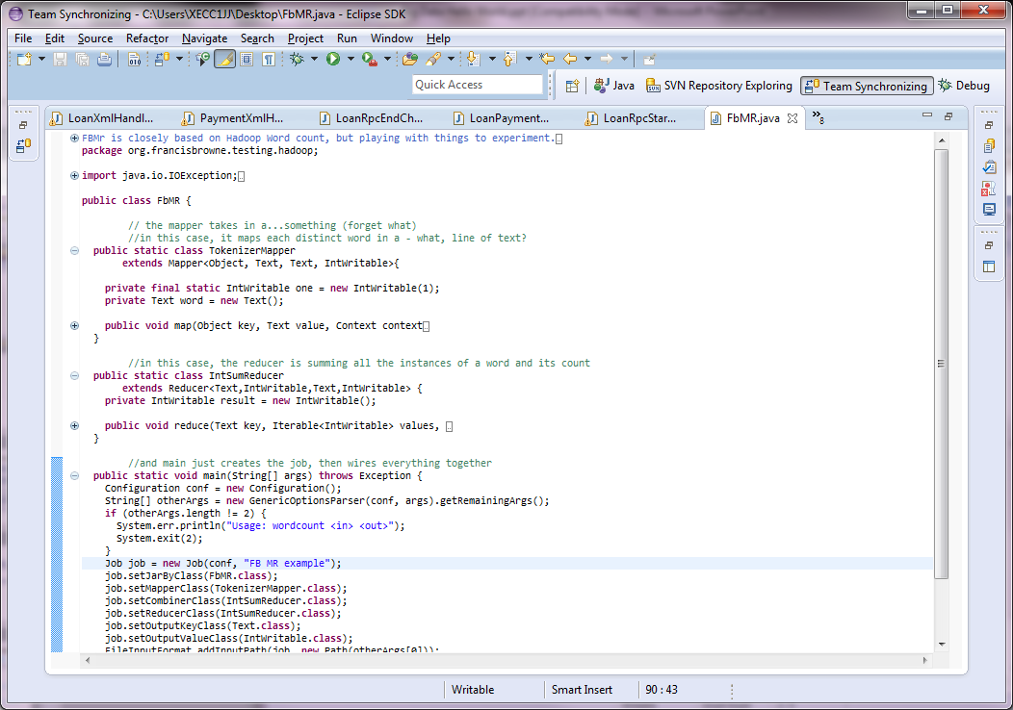
WRITING YOUR OWN HADOOP JOB

Slide 13
DEMO
Code and build walkthrough
Live Demo (the good stuff)

Slide 14
HOW ON EARTH WOULD YOU EVER GET ANYTHING DONE?
This may sound too abstract to be useful. How would you ever do real work in a MapReduce structure?
It isn’t trivial, and I recommend the O’Rielly books Hadoop: The Definitive Guide and MapReduce Design Patterns. But that said, here are some simple examples:
Word count: tokenize the input into words, and for each word, mapper outputs the word as key, followed by a 1 (the number of times it occurred right there). Reducer counts the 1s that come with each key, and outputs that words’ number of occurences. In general, counting patterns will count things in the mappers, then use the reducers to sum those counts across all mappers.
Grouping and summary: map data that has recurring values (Country, etc) – return country value as map key, then some summary data about the row. Reducer performs analysis.
Filtering: determine if individual rows match a pattern. Only output key and value if they do.
Determine the “top ten” of a type of record – which users accessed most, etc. Mapper determines the top 10 of the data that is fed to it (using local object state), and outputs it. Reducer processes those, and throws out each one that is not in the ultimate top ten, then prints them.
Its gets worse from there…joins and sorts can be very tricky, and very expensive operations.

Slide 15
NOW FOR HIVE…
Hive is a SQL-like subsystem implemented directly on top of MapReduce and HDFS.
It is a much higher-level tool (but the high-level view can be misleading if you think about it as an RDBMS instead of a distributed flat file scanner).
It reads loosely structured flat files
Used in Activity Engine’s batch output subsystem
Designed to allow developers to get things done in a Hadoop world, without understanding how to code, or tune, MR jobs.

Slide 16
AN EVEN MORE ROUGH-AND-READY INSTALL PROCESS
Based on this web tutorial https://cwiki.apache.org/confluence/display/Hive/GettingStarted and release 0.12.0
Installed hive to /home/fbrowne/projects/hadoop/hive-0.12.0
Su hduser, export HADOOP_HOME=/usr/local/hadoop/hadoop-2.1.0-beta
Hive expects warehouse to be at /user/hive/warehouse – rather than figure out the places to change hive.metastore.warehouse.dir, I created this path (as I noted, rough and ready)
root@debian-user1-revelstone:/usr# mkdir /user
root@debian-user1-revelstone:/usr# cd /user
root@debian-user1-revelstone:/user# ln -s /home/hduser/hive hive
root@debian-user1-revelstone:/user# ls -l
total 0 lrwxrwxrwx 1 root root 17 Feb 9 02:48 hive -> /home/hduser/hive
hduser@debian-user1-revelstone:/usr/local/hadoop/hadoop-2.1.0-beta/bin$ rm -r ~/hive/warehouse
hduser@debian-user1-revelstone:/usr/local/hadoop/hadoop-2.1.0-beta/bin$ ./hadoop fs -mkdir /home/hduser/hive/warehouse
14/02/09 02:29:25 WARN util.NativeCodeLoader: Unable to load native-hadoop library
for your platform... using builtin-java classes where applicable
hduser@debian-user1-revelstone:/usr/local/hadoop/hadoop-2.1.0-beta/bin$ ./hadoop fs -chmod g+w /tmp
14/02/09 02:29:46 WARN util.NativeCodeLoader: Unable to load native-hadoop library
for your platform... using builtin-java classes where applicable
hduser@debian-user1-revelstone:/usr/local/hadoop/hadoop-2.1.0-beta/bin$ ./hadoop fs -chmod g+w /home/hduser/hive/warehouse
14/02/09 02:29:52 WARN util.NativeCodeLoader: Unable to load native-hadoop library
for your platform... using builtin-java classes where applicable
hduser@debian-user1-revelstone:/usr/local/hadoop/hadoop-2.1.0-beta/bin$

Slide 17
VERY BASIC USEAGE OF HIVE (AS AN EXPENSIVE GREP)
To use the Hive command line interface (CLI) from the shell:
$ export PATH=$PATH:/home/fbrowne/projects/hadoop/hive-0.12.0/bin
hive> LOAD DATA INPATH '/home/hduser/some-latex-text' OVERWRITE INTO TABLE lines;
Loading data to table default.lines
Table default.lines stats: [num_partitions: 0, num_files: 1, num_rows: 0,
total_size: 70934, raw_data_size: 0] OK Time taken: 0.63 seconds
hive> select * from lines where line like '%bf%';
Total MapReduce jobs = 1
Launching Job 1 out of 1
Number of reduce tasks is set to 0 since there's no reduce operator
SLF4J: Class path contains multiple SLF4J bindings.
SLF4J: Found binding in [jar:file:/usr/local/hadoop/hadoop-2.1.0-
beta/share/hadoop/common/lib/slf4j-log4j12-1.6.1.jar!/org/slf4j/impl/StaticLoggerBinder.class]
...
2014-02-09 02:54:57,987 null map = 0%, reduce = 0%
2014-02-09 02:54:59,379 null map = 100%, reduce = 0% Ended Job =
job_local2079327410_0001 Execution completed successfully Mapred Local Task
Succeeded . Convert the Join into MapJoin OK
{\bf GO WEST} be reduced to lesser
(a version of the {\bf X} marker in my
Time taken: 15.399 seconds, Fetched: 5 row(s)

Slide 18
INNER JOINS IN HIVE
hive>CREATE EXTERNAL TABLE users (name STRING, id INT)
ROW FORMAT DELIMITED FIELDS TERMINATED BY '\054';
hive>LOAD DATA LOCAL INPATH
'/tmp/hiveinput1' OVERWRITE INTO
TABLE users;
hive>select * from users;
hive>CREATE EXTERNAL TABLE magicwords (userid INT, word STRING)
ROW FORMAT DELIMITED FIELDS TERMINATED BY '\054';
LOAD DATA LOCAL INPATH
'/tmp/hiveinput2' OVERWRITE INTO
TABLE magicwords;
hive>select magicwords.*, users.*
from magicwords JOIN users ON ( users.id = magicwords.userid )
where name like 'Joe%';
Execution completed successfully
Mapred Local Task Succeeded . Convert the Join into MapJoin
OK
1 Foo Joe Smith 1
1 Bar Joe Smith 1
1 Baz Joe Smith 1
Time taken: 23.437 seconds, Fetched: 3 row(s)

Slide 19
DEMO
Viewing Input Files
Live Query Demo –
Trivial SELECT
JOINS across tables
EXPLAIN PLAN for Hive

Slide 20
FURTHER READING
Books:
    O’Rielly Hadoop: The Definitive Guide and MapReduce Design Patterns
    Sadalage and Fowler’s NoSQL Distilled
  Web Tutorials:
    http://www.michael-noll.com/tutorials/running-hadoop-on-ubuntu-linux-single-node-cluster/
    https://cwiki.apache.org/confluence/display/Hive/GettingStarted
  Product Websites:
    http://hadoop.apache.org/
    http://hive.apache.org/
  BMYM Internal Resources (these are very good)
    Getting data INTO Hive in Activity Engine
      https://ecommerce.bnymellon.net/sites/eCommerce/css/architecture/activityEngine/ActivityEngineModules/Tutorial-FileImport.aspx
      https://ecommerce.bnymellon.net/sites/eCommerce/css/architecture/activityEngine/ActivityEngineModules/Tutorial-BulkImport.aspx
    Getting data OUT OF Hive in Activity Engine
      https://ecommerce.bnymellon.net/sites/eCommerce/css/architecture/activityEngine/ActivityEngineModules/Tutorial-HiveScript.aspx

